Slide 1
Fit Pulse – AI-Driven Smartwatch Health Analytics & Anomaly Detection
Intelligent wellness monitoring powered by data cleaning, anomaly detection, and real-time insights.

Slide 2
Milestone 2: Objectives
Objectives:
Extract statistical & temporal features from fitness data
Forecast future values for heart rate, sleep duration, and steps
Integrate with Milestone 1 preprocessing pipeline for end-to-end processing

Slide 3
Importance of Feature Extraction
Why Feature Extraction?
Converts raw time-series sensor data into measurable insights
Helps identify trends, anomalies, and behavioural patterns
Enables more accurate forecasting
Examples:
Mean, maximum, variance, rolling averages, trend slope
New Terms:
Feature Extraction: Converting raw signals into meaningful metrics
Time-Series Features: Numerical indicators summarizing temporal behaviour

Slide 4
Overview of Milestone-2 Tasks
Milestone-2 contains three forecasting tasks using Prophet:
Task 1: Forecast Heart Rate
Task 2: Sleep Duration Forecasting with Weekly Seasonality
Task 3: Step Count Forecasting with Events & Holidays
Each task uses synthetic daily fitness data to demonstrate trend modelling, seasonality understanding, and event-based forecasting.

Slide 5
Task 1: Heart Rate Forecasting
Goal:
Train on 60 days of data
Forecast next 14 days
Evaluate accuracy using MAE
Approach:
Prophet model with trend + small weekly pattern
Compare forecast vs. actual test data
Extract Day-67 forecast value
Outputs to show:
Plot: train + test + forecast + confidence interval
MAE score
Day-67 predicted HR

Slide 6
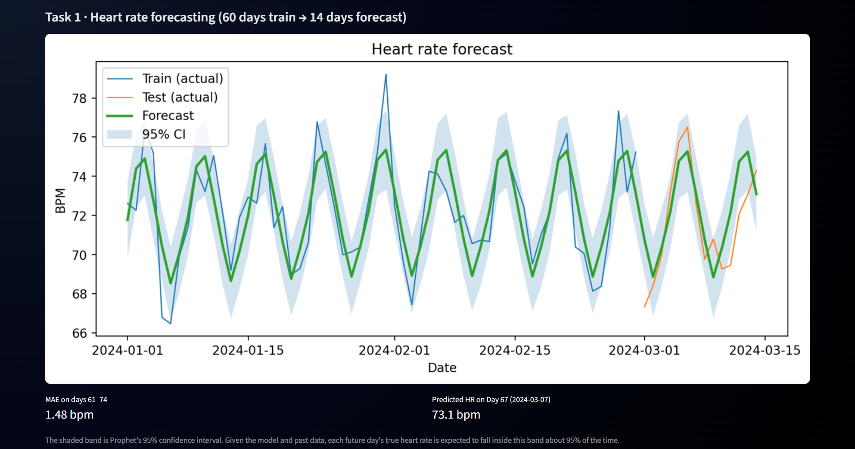

Slide 7
Task 2: Sleep Duration Forecasting
Goal:
Model 90 days of sleep data
Identify weekly seasonality (weekday vs weekend sleep)
Forecast next 7 days
Approach:
Enable Prophet’s weekly seasonality
Analyze trend (increasing, decreasing, flat)
Identify best and worst sleep days
Outputs to show:
Forecast plot
Components plot (trend + seasonal)
Best & worst sleep days

Slide 8
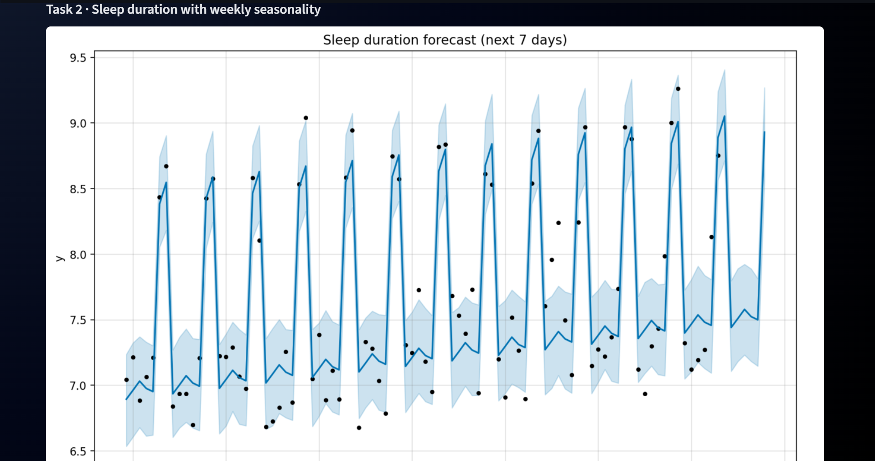

Slide 9
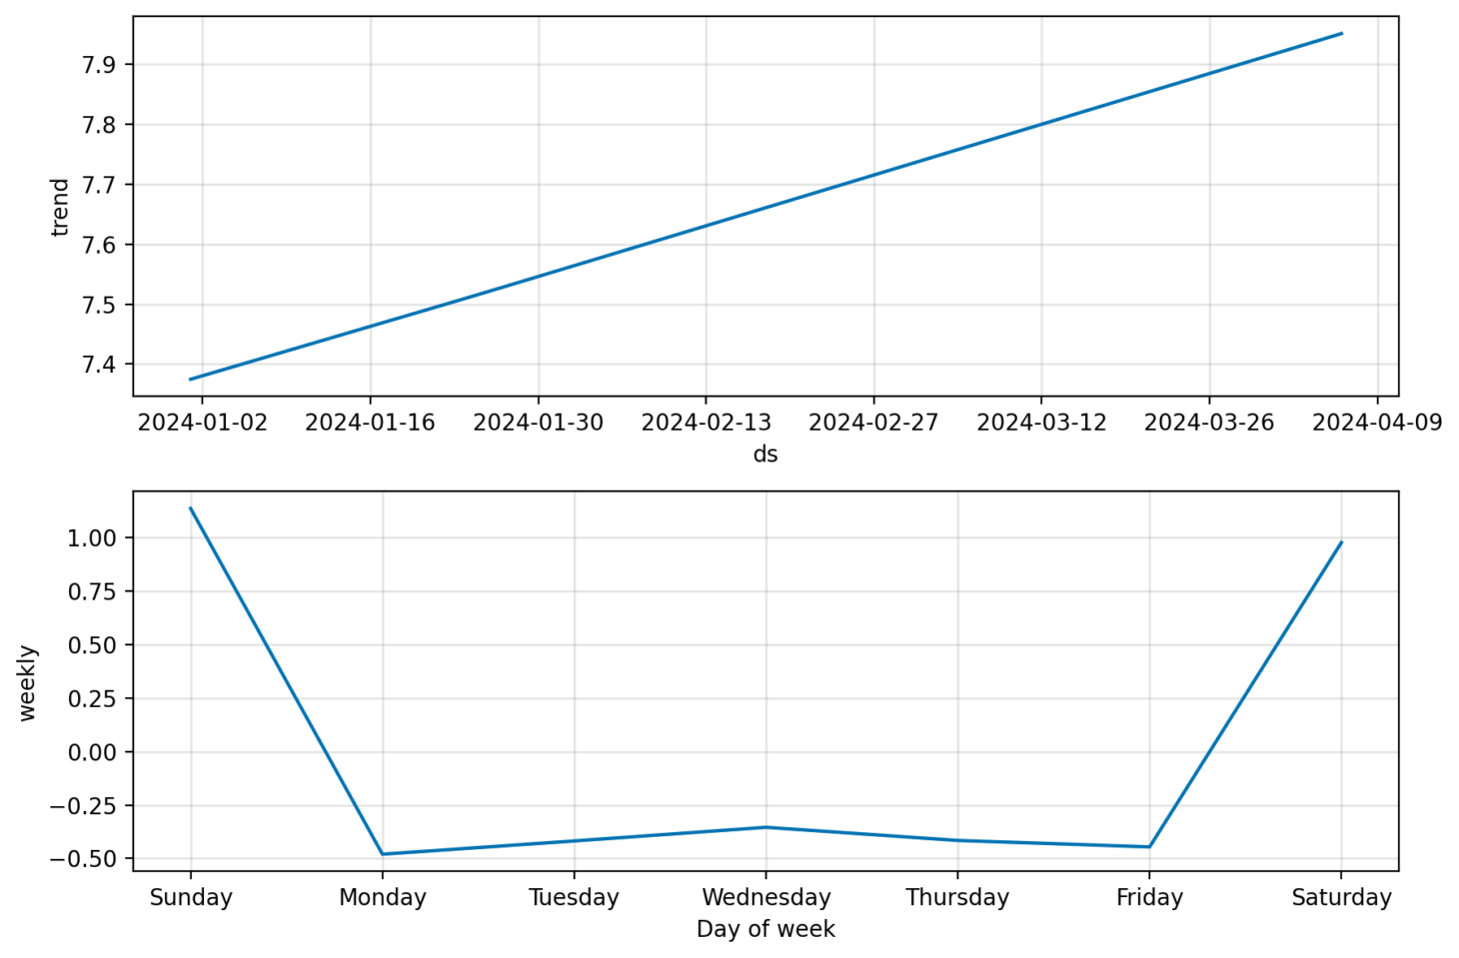

Slide 10
Task 3: Step Count Forecasting with Events
Goal:
Forecast steps for 120 days
Understand effects of events like vacation, sickness, marathon
Approach:
Add holiday/event dataframe in Prophet
Train two models:
  Without holidays
  With holidays
Compare predictions
Outputs to show:
Forecast without holidays
Forecast with holidays
Event impact comparison (vacation, sick, marathon)

Slide 11
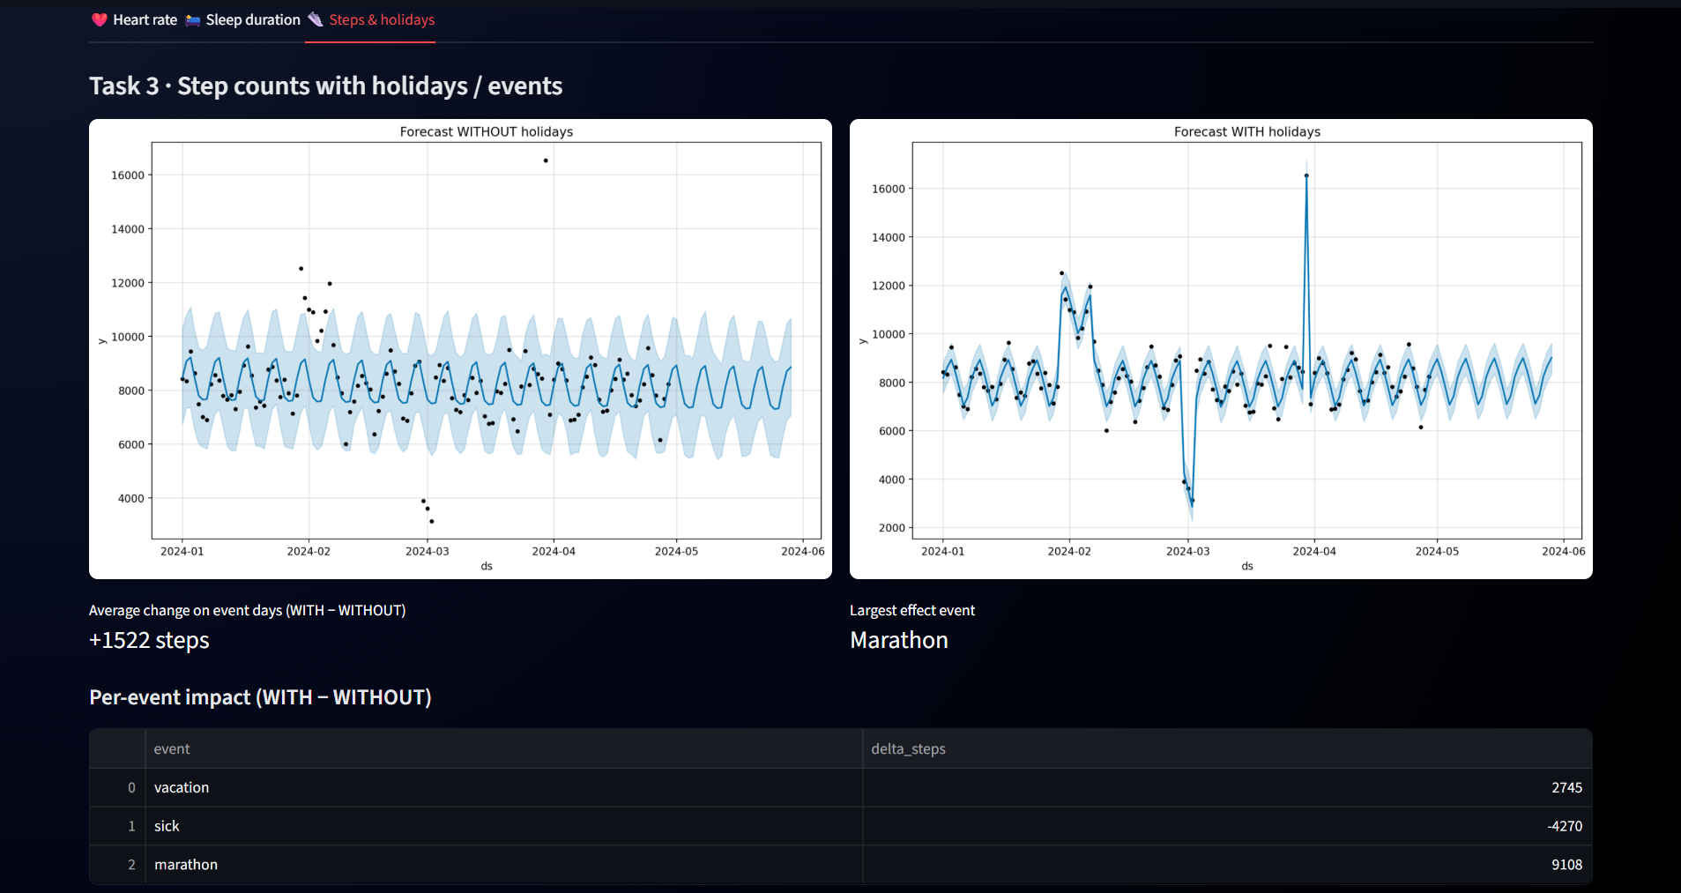

Slide 12
Thank You

